Slide 1
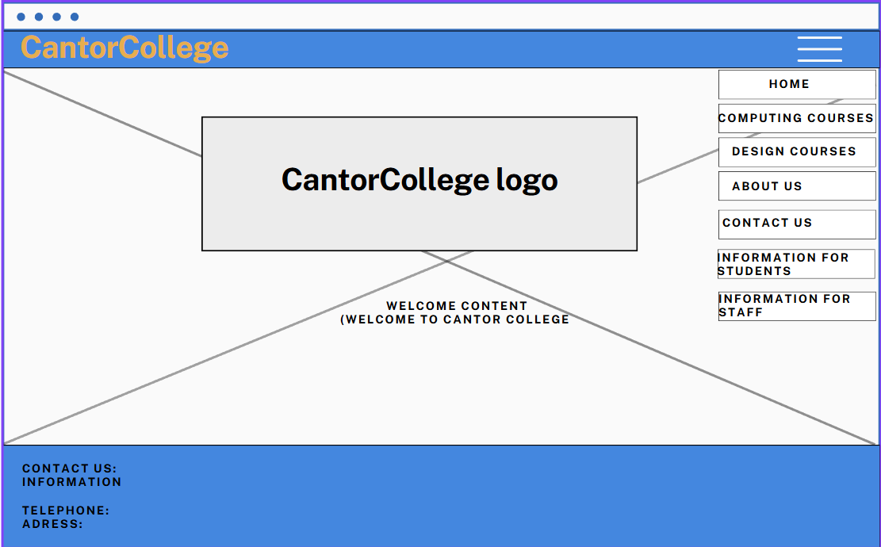
The website is bigger so there is space for navigation menu to be open
Desktop wireframe design
Header= holds the cantor college name with navigation menu through out the website staying at the top of pages
Footer= holds the contact information through the website staying at the bottom of the pages
Content section where main content is displays like logo, text, paragraphs.
Menu= navigation menu displays links to other pages in the website

Slide 2
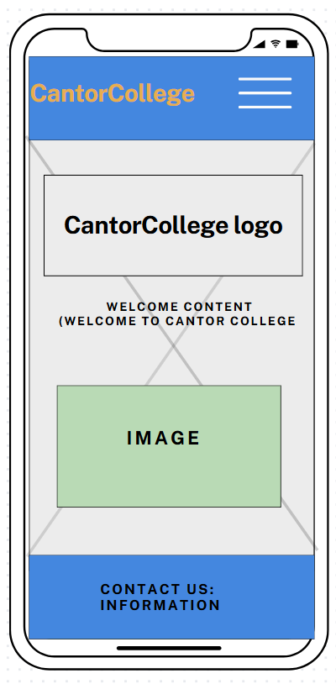
Mobile wireframe design
Header= holds the cantor college name with navigation menu on top right through out the website staying at the top of pages
Footer= holds the contact information through the website staying at the bottom of the pages
Content section where main content is displays like logo, text, paragraphs, images.
Menu= navigation menu displays links to other pages in the website
The display is mobile which means smaller size to fit accordingly so the navigation menu is closed and open when clicked

